Slide 1



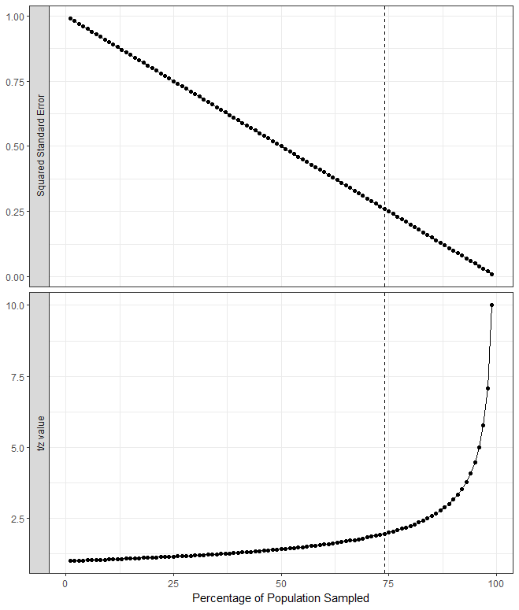
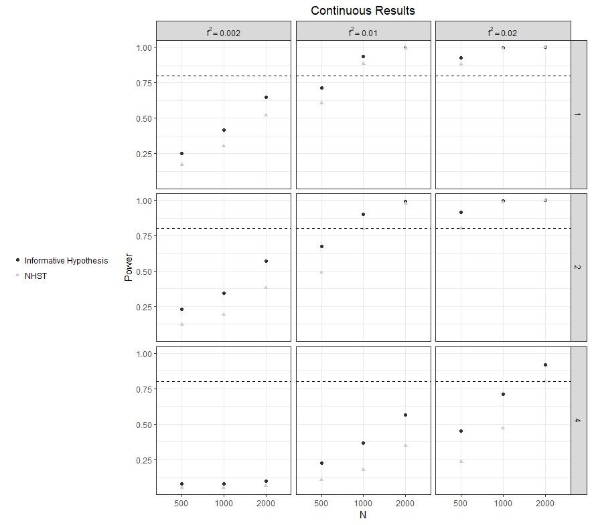
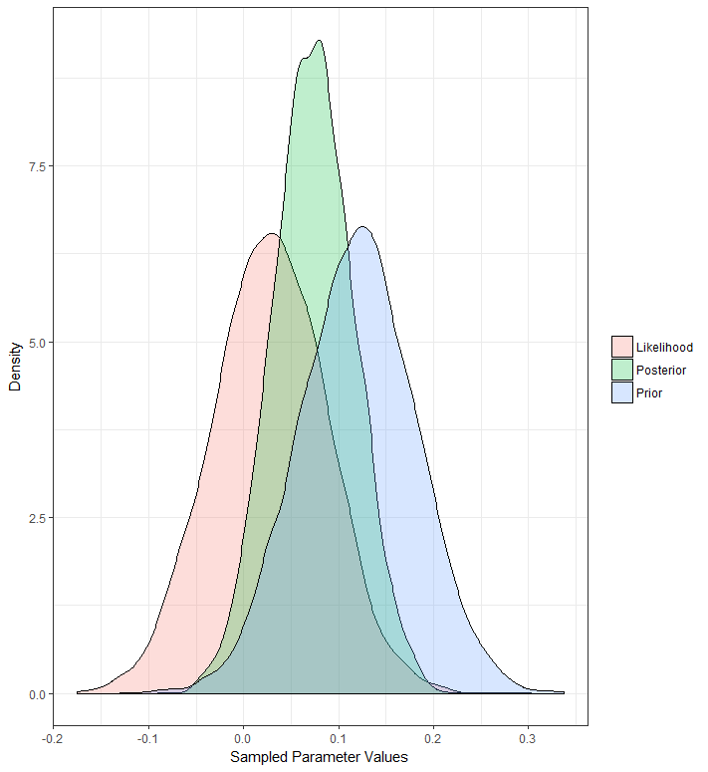
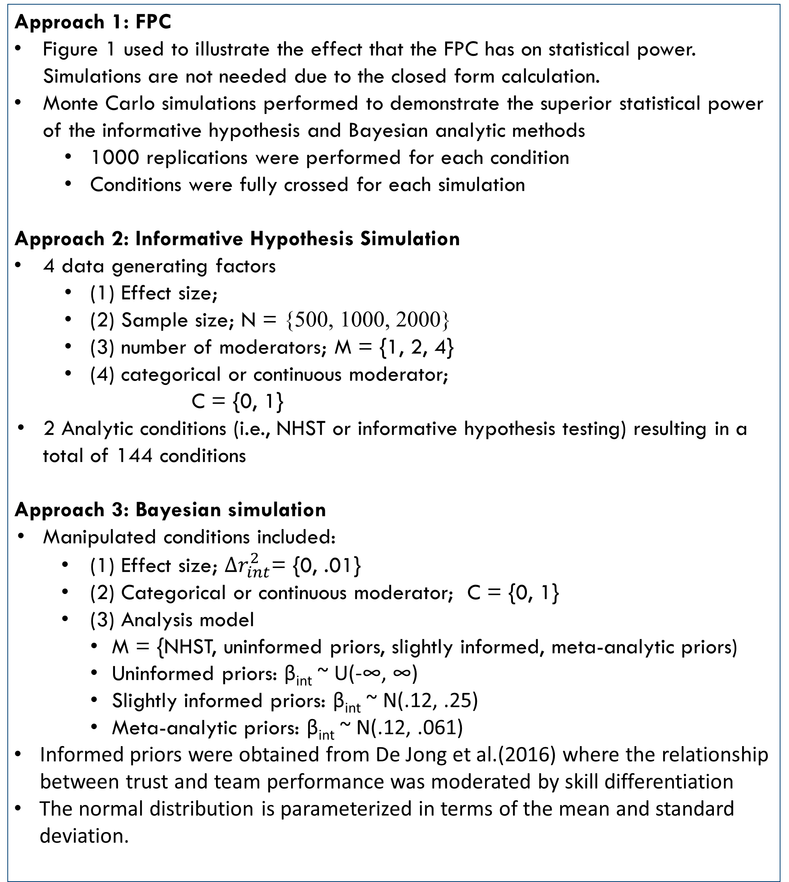
Houston F. Lester¹, Natalie A. Koziol², & Sylvia J. Hysong^{1,3}
¹Center for Innovations in Quality Effectiveness and Safety, Michael E. DeBakey VA Medical Center, ² Nebraska Center for Research on Children, Youth,
Families & Schools, University of Nebraska-Lincoln, ³ Baylor College of Medicine, Houston, TX
Improving Power to Detect Moderation
Background and Objectives
Method
Figures
Results cont.
A lack of power to detect interaction terms in the organizational sciences has been lamented for many years (Aguinis, Beaty, Boik, & Pierce, 2005; Murphy & Russell, 2017).
The situation is so dire that some researchers have concluded that typical methodological practices to detect interactions should be mended or the search for moderators should be suspended (Murphy & Russell, 2017).
Typical mends to the search for moderators include obtaining larger samples, looking for moderation in well developed research areas, or increasing measurement reliability. These remedies are not always feasible.
Objectives of the Current Study
Describe three analytical alternatives that provide increased power relative to typical null hypothesis significance testing without increasing sample size or effect size requirements.
Describe when these alternatives are appropriate.
Conduct simulation studies and provide analytical descriptions to demonstrate their superior statistical power.
Approach 1: FPC
Figure 1 used to illustrate the effect that the FPC has on statistical power. Simulations are not needed due to the closed form calculation.
Monte Carlo simulations performed to demonstrate the superior statistical power of the informative hypothesis and Bayesian analytic methods
1000 replications were performed for each condition
Conditions were fully crossed for each simulation
Approach 2: Informative Hypothesis Simulation
4 data generating factors
(1) Effect size;
(2) Sample size; N = {500, 1000, 2000}
(3) number of moderators; M = {1, 2, 4}
(4) categorical or continuous moderator;
C = {0, 1}
2 Analytic conditions (i.e., NHST or informative hypothesis testing) resulting in a total of 144 conditions
Approach 3: Bayesian simulation
Manipulated conditions included:
(1) Effect size; ${Δr}_{int}^{2}$= {0, .01}
(2) Categorical or continuous moderator; C = {0, 1}
(3) Analysis model
M = {NHST, uninformed priors, slightly informed, meta-analytic priors)
Uninformed priors: β_{int} ~ U(-∞, ∞)
Slightly informed priors: β_{int} ~ N(.12, .25)
Meta-analytic priors: β_{int} ~ N(.12, .061)
Informed priors were obtained from De Jong et al.(2016) where the relationship between trust and team performance was moderated by skill differentiation
The normal distribution is parameterized in terms of the mean and standard deviation.
However, this is not a limitation of the method. It is simply a byproduct of the posterior being a weighted average of the likelihood and the prior (see Figure 3 for more illustration).
Discussion
Summary: We presented three methods that can increase statistical power relative to NHST without increasing the effect or sample size. In other words, at a given sample and effect size, these methods have more power than traditional NHST. Each method is applicable in a different situation.
FPC is appropriate when the researcher has a finite population and takes a random sample from that population. A practical situation where this may occur is if you are working as an internal consultant at a company and do not seek to generalize your findings beyond the single company.
Informative hypotheses are appropriate when the researcher possesses rank-ordering hypotheses. These sorts of hypotheses are likely made most times that researchers investigate moderation. For example, when proposing an ability by training interaction, it is hypothesized that the training is more effective for those with more ability. Thus, the interaction term should be positive.
Bayesian analysis with informed priors is appropriate when there is prior information to draw upon. Researchers may not like the subjectivity that this may bring into the analysis, but in general a sensitivity analysis can be conducted to see the effects that the prior is having on the posterior inferences (Depaoli & van de Schoot, 2015)
Future directions: We presented the Bayesian analysis and informative hypotheses as if they were two separate approaches when in fact they can be combined with one another. However, the purpose of this paper was to introduce more powerful alternatives and to limit the complexity of applying these analyses. Future research can evaluate combinations of Bayesian analysis with/without informative priors and informative hypothesis testing to see if they provide additional power increases occur with the small effect sizes commonly seen in the organizational sciences.
Figure 1. Squared standard error magnitude and t/z-test statistic value by percent sampled.
Analytical Approaches
Approach 1: Finite Population Correction (FPC; Smith, 1976)
Typical methods assume the population is infinite, but that is not always the case (e.g., Nobel laureates in Literature is a finite and numerable population)
This method simply involves multiplying the typical standard errors by 1- (n/N) where n is the sample size and N is the population
This results in decreased standard errors and larger z/t statistics for the corresponding regression coefficients
Approach 2: Informative Hypothesis Tests (Silvapulle & Sen, 2005)
Assess the rank ordering hypotheses that researchers likely have regarding the coefficients of interest.
For example, if a relationship between a predictor and criterion of interest is moderated by gender, the researcher may believe that females have a larger slope.
Two-step hypothesis test
H_{β0}: β_{males} < β_{females} vs H_{β1}: β_{males} ≠ β_{females}
H_{A0}: β_{males} = β_{females} vs H_{A1}: β_{males} < β_{females}
Power defined as the probability of failing to reject hypothesis H_{β0} times the probability of rejecting hypothesis H_{A0} given that H_{β0} was not rejected. Mixture F statistic is used to calculate the p-values
Approach 3: Bayesian Inference (e.g., Gelman et al., 2014)
Accounts for parameter value uncertainty by treating parameters as random variables (Kaplan, 2014)
Priors are used to quantify the initial plausibility of each possible parameter value
Can either be informative or not informative
Informed priors can increase statistical power if they are centered and concentrated away from the null effect. Uninformed priors should not affect power
Results
Approach 1: FPC
Figure 1 contains the FPC results. The gain in power is approximately linear until 75% of the population is sampled. Then the increase in power accelerates. The results displayed correspond to a t/z-statistic of 1 using standard methods.
Approach 2: Informative Hypothesis Tests
Informative hypothesis tests always have a power greater than or equal to the NHST analysis (see Figure 2).
As expected, power was larger with larger sample sizes and effect sizes
Larger power gains were found for the informative hypothesis approach as the number of moderators increased with the exception of the smallest non-zero effect size.
Only the continuous moderator conditions are displayed in Figure 2. Categorical results followed the same pattern.
Type I error fell between .03 and .07 as would be expected for α = .05. The average type I error rate across the conditions was .055 for NHST and .053 for the informative hypothesis tests.
Approach 3: Bayesian Analysis
The uninformed power results matched the NHST (i.e., power = .20), the power was larger for both the slightly informed (.21) and meta-analytic informed priors (.67).
Importantly, incorrect informed priors resulted in inflated type I error rates (.17).
Bayesian analysis provides power advantages when the researcher possesses prior knowledge regarding the effect size and the effect size is concentrated away from zero. However, if that prior is incorrect, the ultimate posterior inferences will be negatively affected.
References
Aguinis, H., Beaty, J. C., Boik, R. J., & Pierce, C. A. (2005). Effect size and power in assessing moderating effects of categorical variables using multiple regression: A 30-year review. Journal of Applied Psychology, 90, 94-107. doi: 10.1037/0021-9010.90.1.94
De Jong, B. A., Dirks, K. T., & Gillespie, N. (2016). Trust and team performance: A meta-analysis of main effects, moderators, and covariates. Journal of Applied Psychology, 101, 1134. doi: 10.1037/apl0000110
Depaoli, S., & van de Schoot, R. (2015). Improving transparency and replication in Bayesian statistics: The WAMBS-checklist. Psychological Methods, 22, 240-261. DOI: 10.1037/met0000065
Gelman, A., Stern, H. S., Carlin, J. B., Dunson, D. B., Vehtari, A., & Rubin, D. B. (2013). Bayesian data analysis (3rd ed.). Chapman and Hall/CRC.
Kaplan, D. (2014). Bayesian statistics for the social sciences. New York: Guilford Press.
Murphy, K. R., & Russell, C. J. (2017). Mend it or end it: Redirecting the search for interactions in the organizational sciences. Organizational Research Methods, 20, 549-573. doi: 10.1177/1094428115625322s
Silvapulle, M. J., & Sen, P. K. (2005). Constrained Statistical Inference: Inequality. Order and Shape Restrictions. Wiley.
Smith, T. M. F. (1976). The foundations of survey sampling: A review. Journal of the Royal Statistical Society. Series A, 139, 183-204. doi: 10.2307/2345174
Figure 2. Empirical power presented by sample size, hypothesis test, and number of moderators. The .80 power criterion is denoted by a dashed horizontal line. This is a criterion that is often used when designing a study.
Figure 3. Meta-analysis prior, likelihood, and posterior densities for the interaction regression coefficient.

